Slide 1
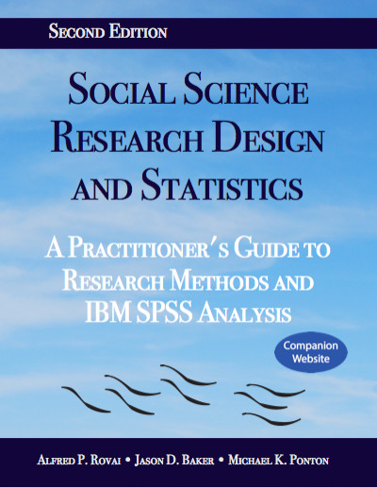
Social Science Research Design and Statistics, 2/e
Alfred P. Rovai, Jason D. Baker, and Michael K. Ponton
Computing Variables
PowerPoint Prepared by
Alfred P. Rovai
IBM® SPSS® Screen Prints Courtesy of International Business Machines Corporation,
© International Business Machines Corporation.

Slide 2
Computing Variables
Compute a new numeric or string variable or replace an existing variable based on data transformation.
  A variety of built-in functions are available for use.
Use the If Cases dialog to apply data transformations to selected subsets of cases using conditional expressions.
  A conditional expression returns a value of true, false, or missing for each case.

Slide 3
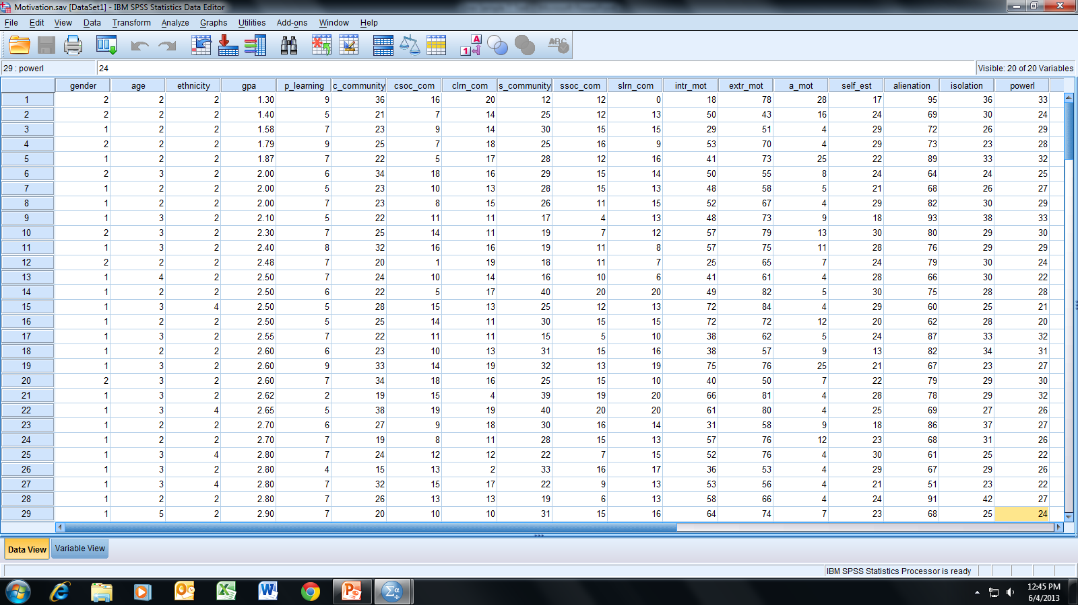
Open the dataset Motivation.sav.
File available at http://www.watertreepress.com/stats

Slide 4
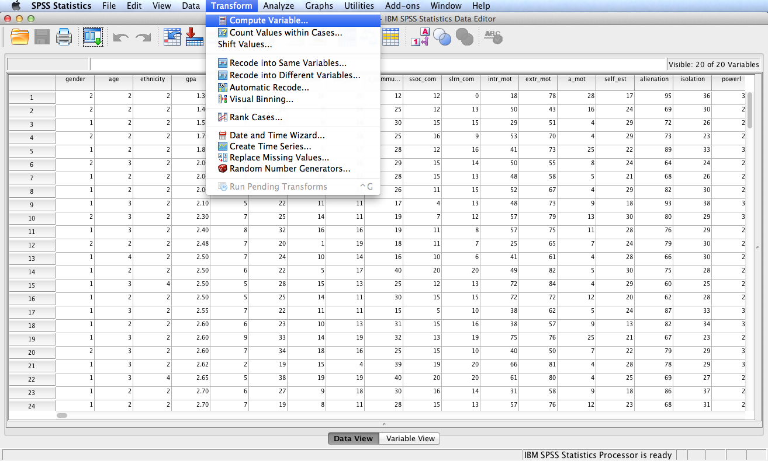
Follow the menu as indicated.

Slide 5
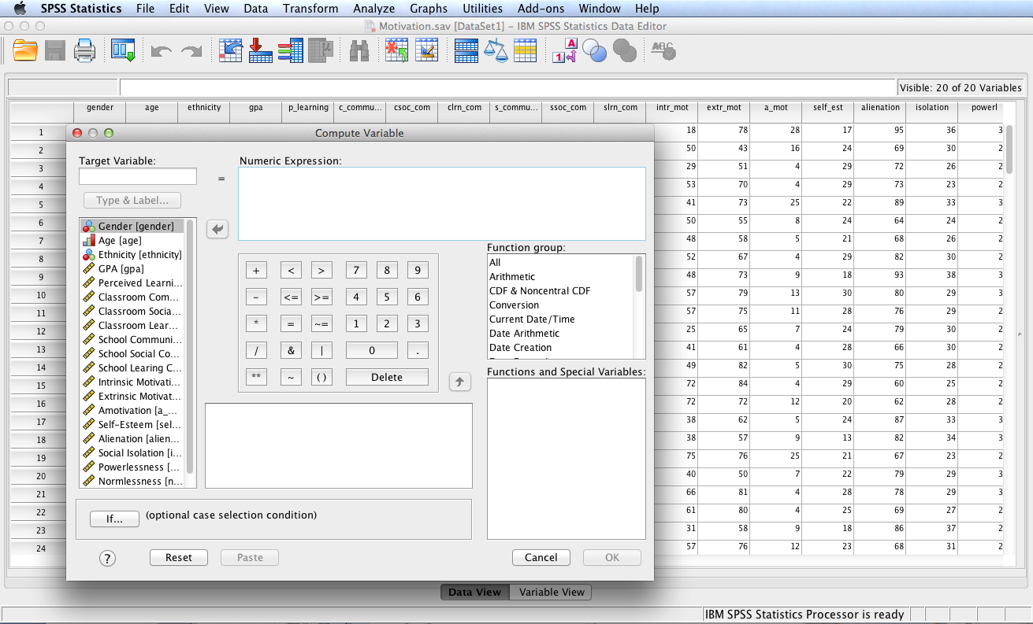
In this example, we will compute a new variable, zgpa, by transforming
variable gpa into a new variable with standard normal distribution N(0,1).
We will use the following formula to compute z-scores from raw scores:
Z = (X – M)/SD

Slide 6
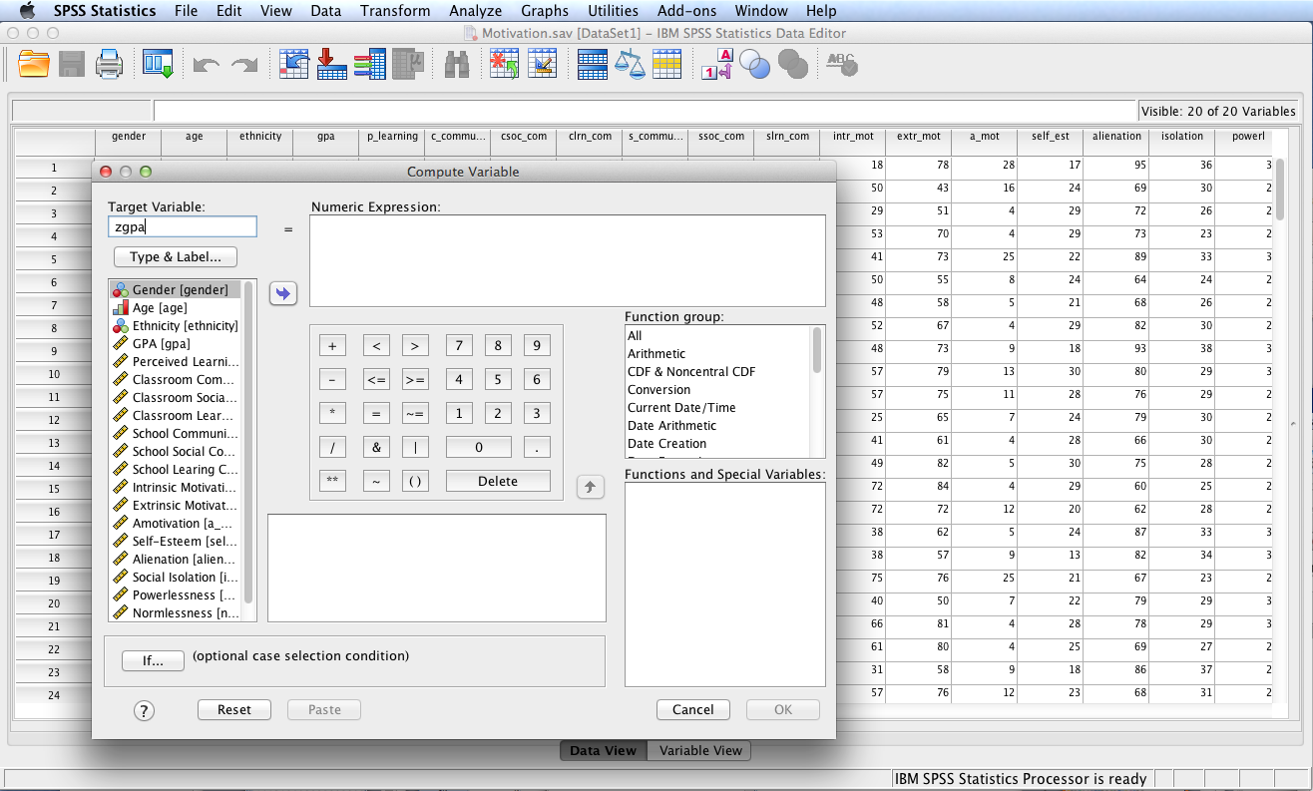
Enter zgpa in the Target Variable: box.

Slide 7
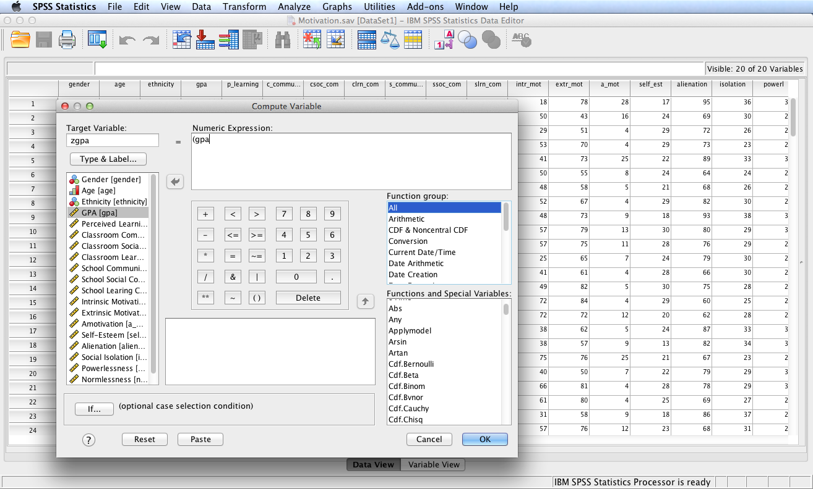
Now enter the numeric expression based on the formula of Z = (X – M)/SD. Since X represents the raw scores, gpa, start the numeric expression by entering “(gpa” as shown. To complete the entry one must first determine the values of M and SD for gpa, which will be done next.

Slide 8
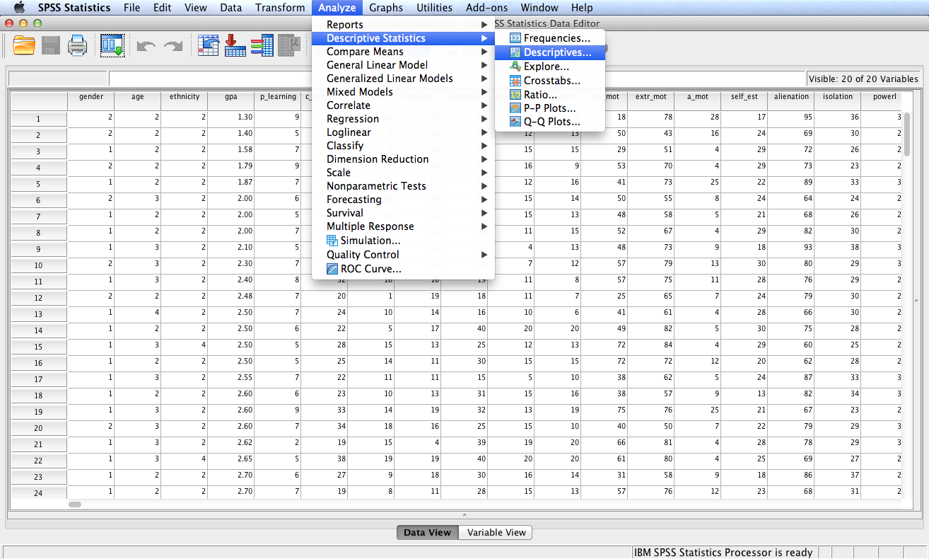
Follow the menu as indicated to obtain M and SD for GPA.

Slide 9
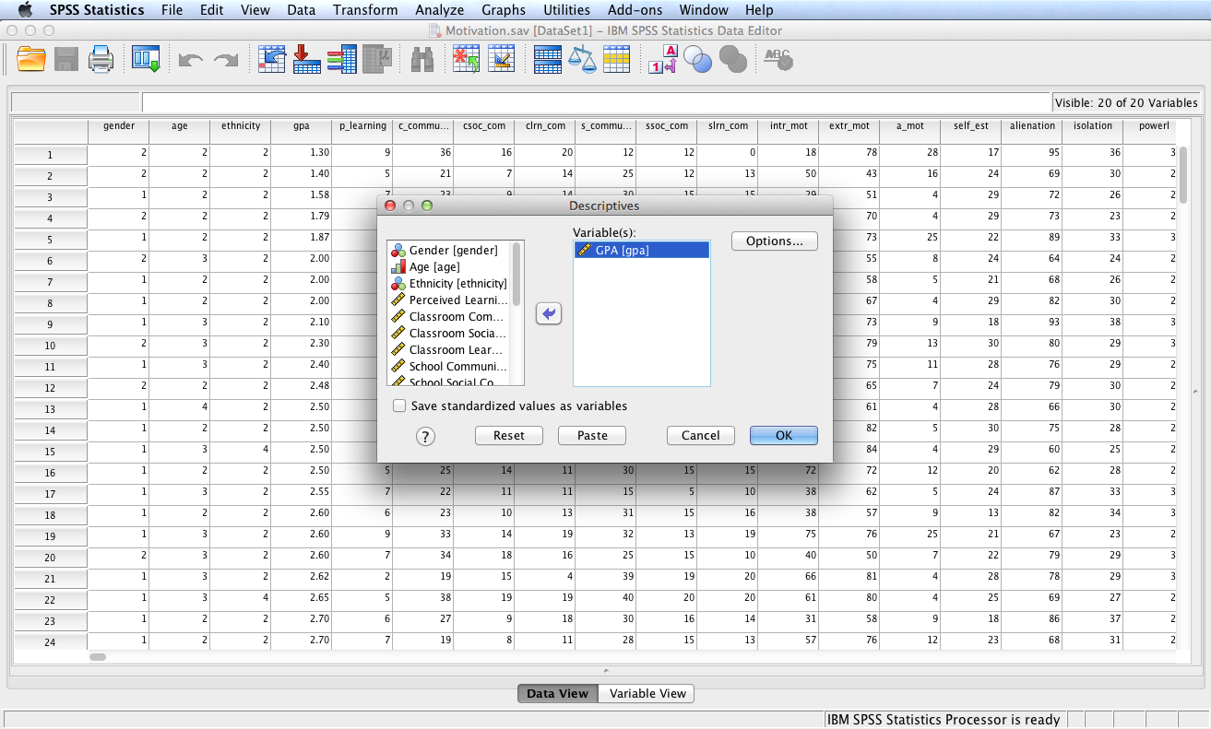
Move gpa to the Variable(s): box. Click OK.

Slide 10
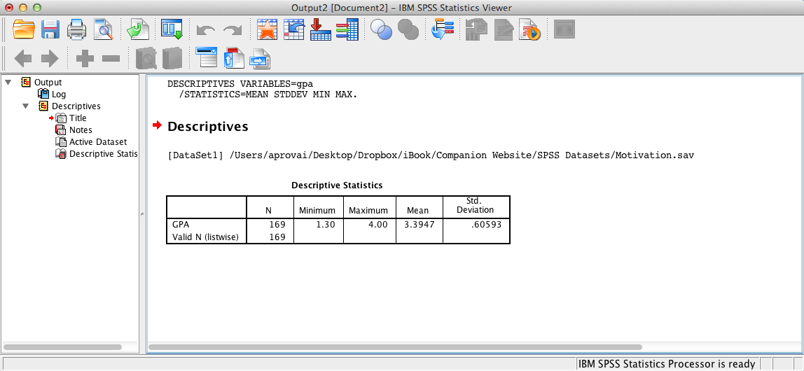
SPSS Output
Note the M and SD in the SPSS output window. Use these values in the Numeric Expression: box of the Compute Variable dialog.

Slide 11
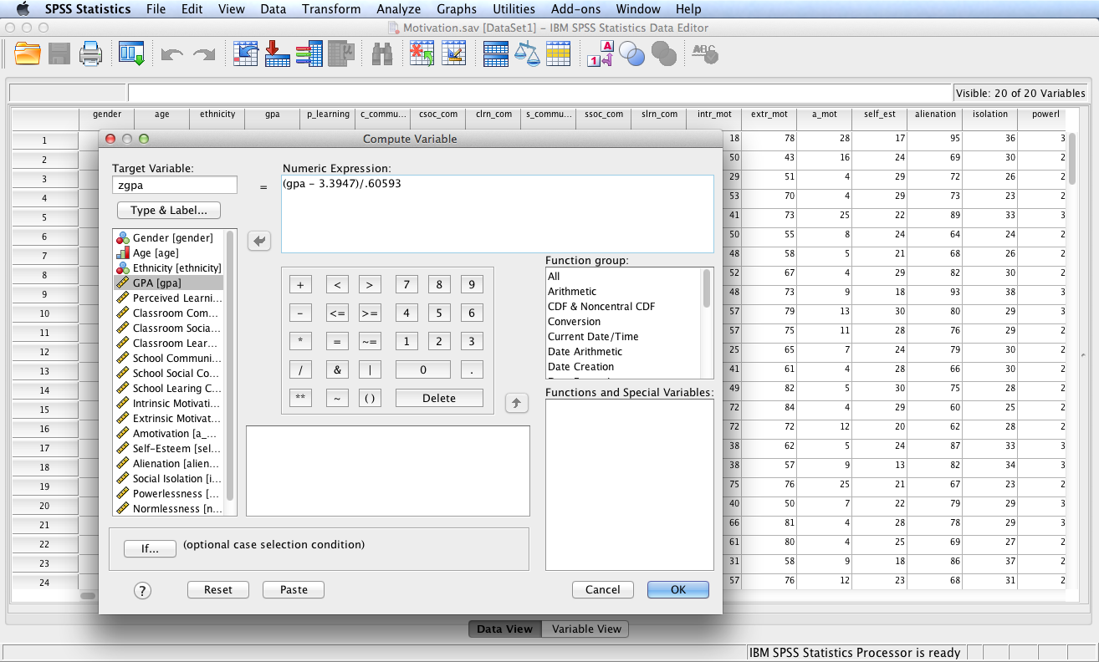
Complete the numeric expression in the Compute Variable dialog based on the formula Z = (X – M)/SD, where X = gpa, M = 3.3947, and SD = 60593. Click OK.

Slide 12
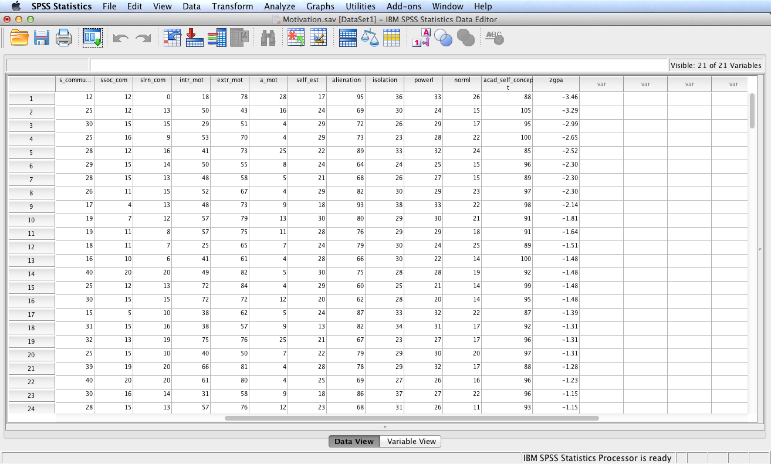
SPSS computed and added a new variable, zgpa, to Data View based
on the Compute Variable procedure.

Slide 13
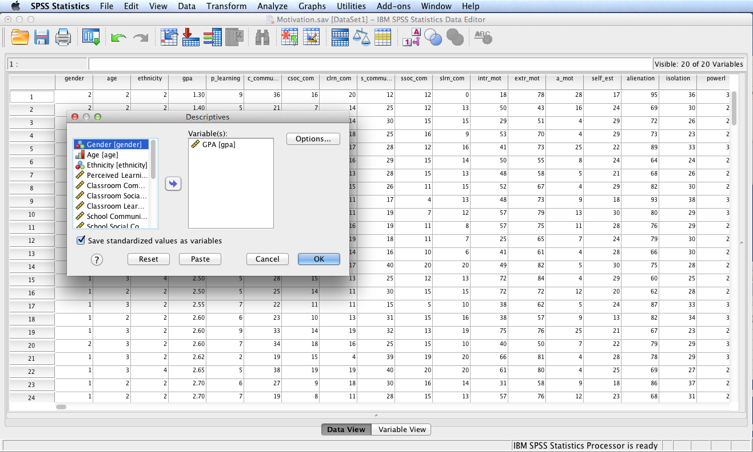
An alternative procedure for creating a new variable consisting of z-scores for variable gpa is to check the Save standardized values as variables box in the Descriptives dialog. SPSS output will display gpa descriptives and concurrently add a new variable named Zgpa to Data View.

Slide 14
End of Presentation

